Slide 1

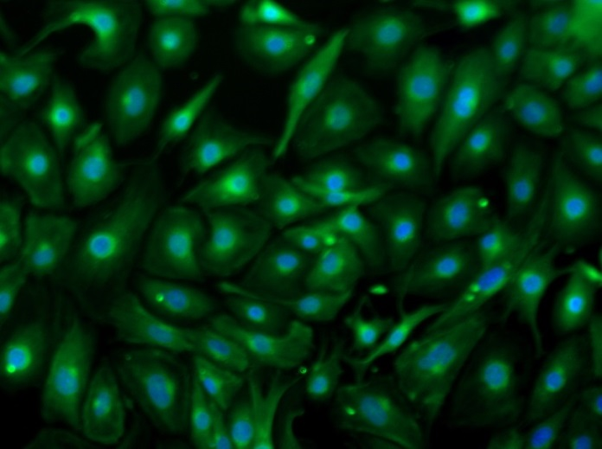
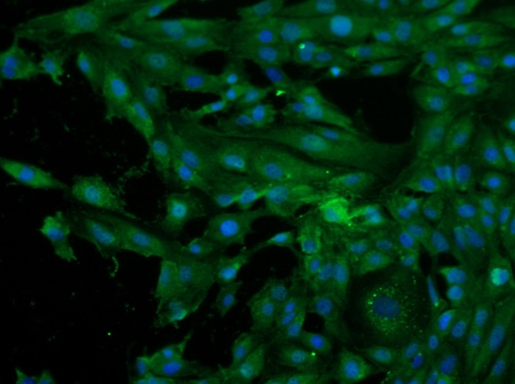
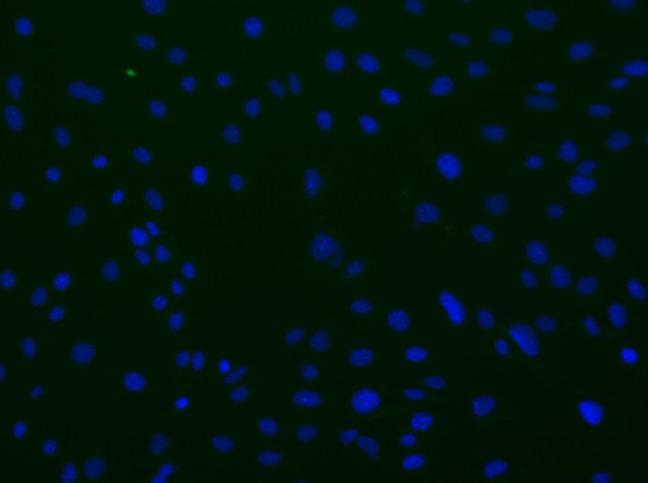
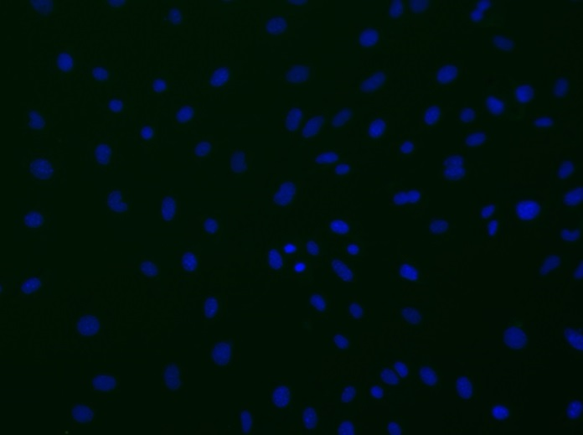
Reliatech GmbH
Mouse anti-human VEGF-A / PlGF
(Cat# 101-M58; 101-M65 [10 µg/ml]; SnoMec)
Immunofluorescence staining of mouse VEGF-A (#101-M58) and PlGF (#101-M65) in primary mouse endothelial cells (SnoMec) using monoclonal antibodies directed against human VEGF-a and human PlGF, respectively.
As secondary antibody goat anti-mouse ALEXA Flour 488 (Dianova; 1:600) was used.
[IF_mEC1407-02]
.
mouse anti-human VEGF-A
mouse anti-human PlGF
Control (goat anti-mouse IgG ALEXA Flour 488; 1:600)
http://www.reliatech.de / orders@reliatech.de

